Slide 1
Exporting into GPS and saving images

Slide 2
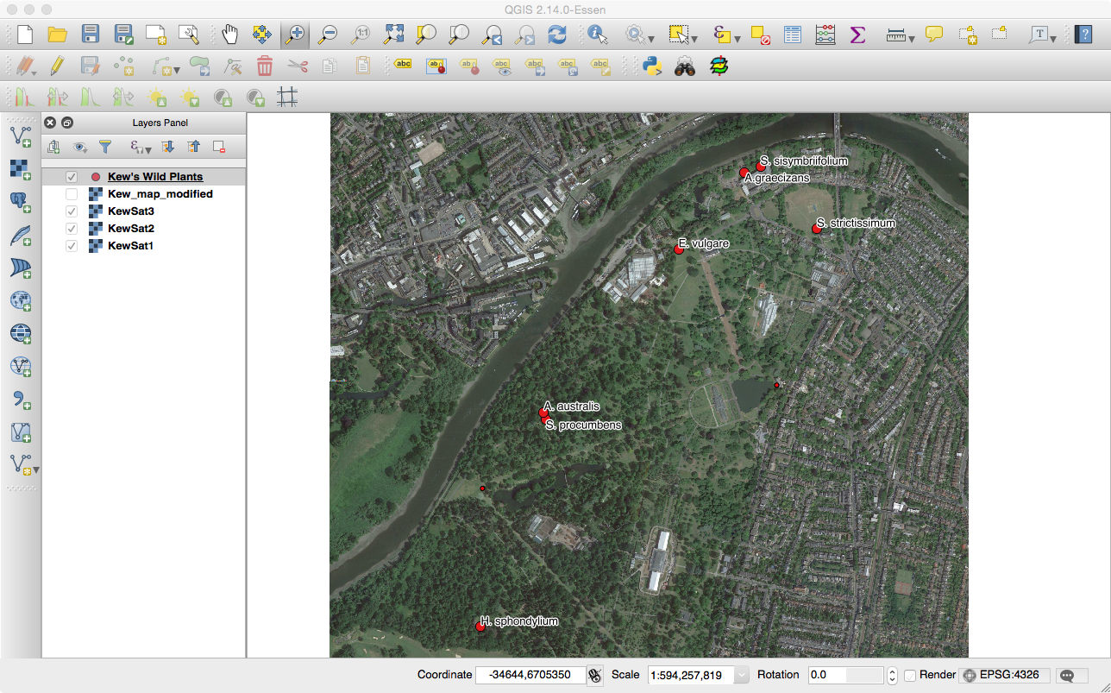
Come back to the same project
Edit so that we have colours based on year

Slide 3
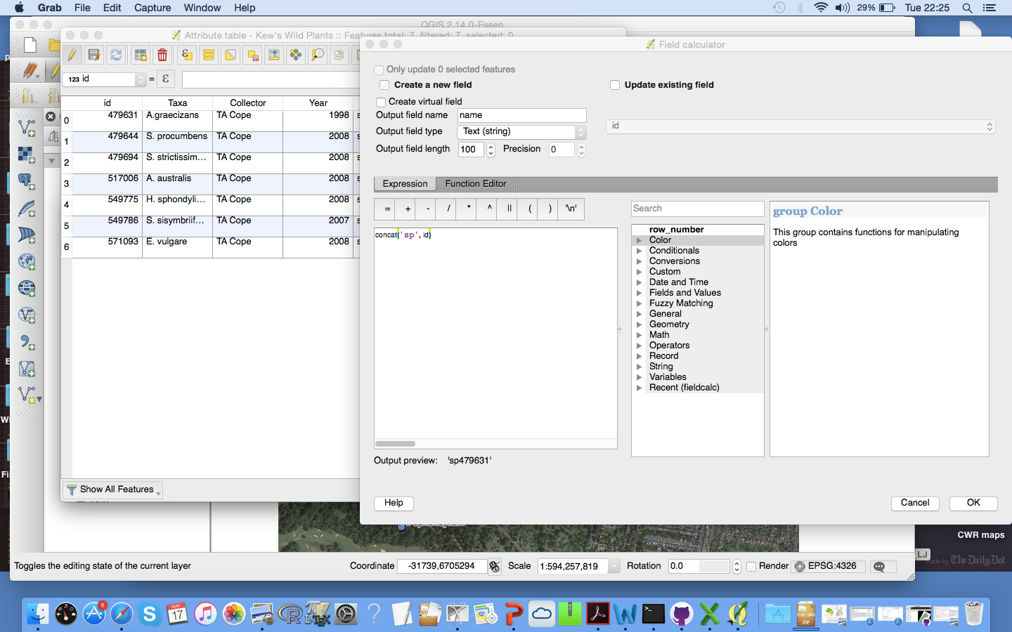
To change to GPX
Add a new column – open attribute table > field calculator
Create new field > name (small casing!) > text > 100 character
Concat(‘sp’, id)
Ok
Save and untoggle edit
SAVE, REPEAT

Slide 4
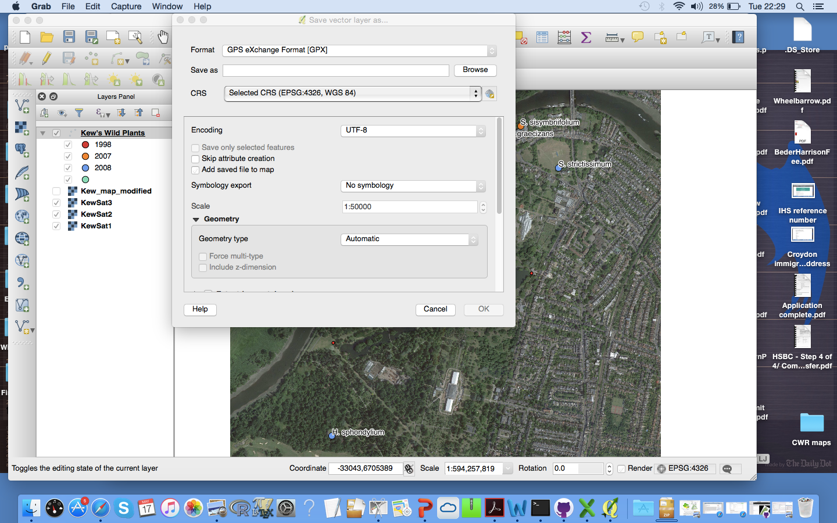
Right click
Save as GPX
Name “To verify in the field”
Load into the project
Choose the ‘WAYPOINTS’
SAVE AND REPEAT

Slide 5
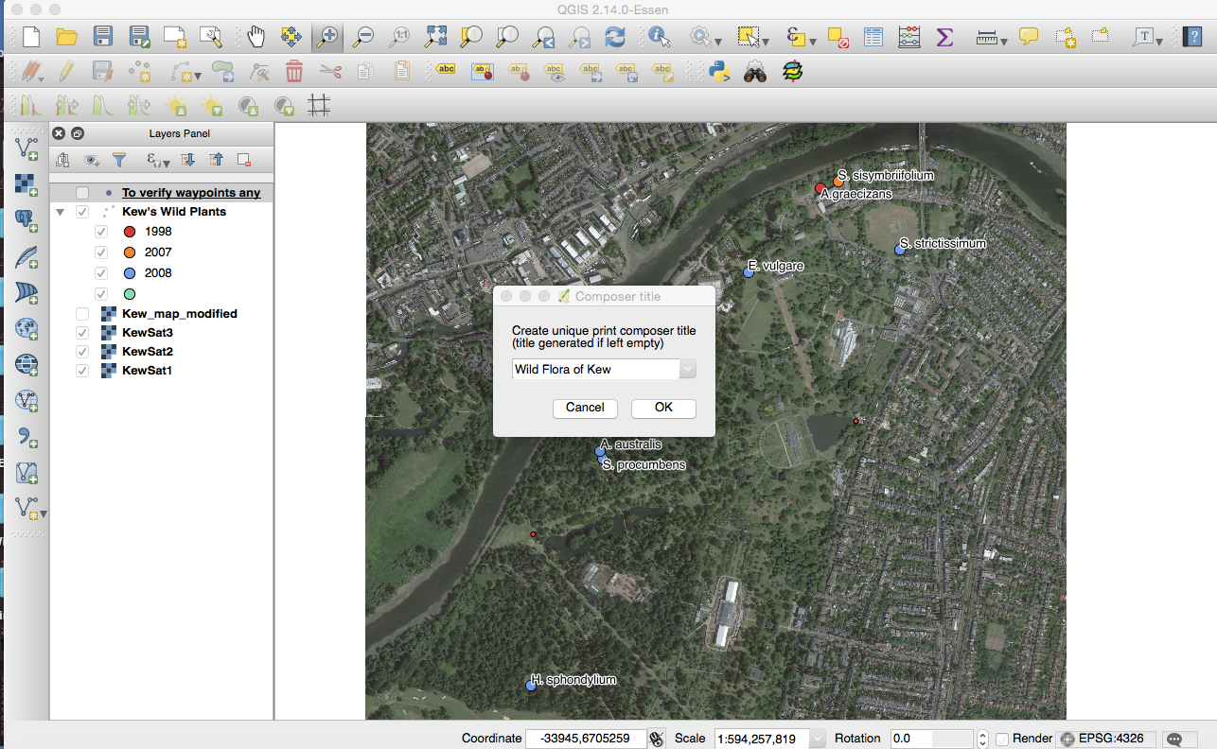
Print composer > New print composer > Wild Flora of Kew

Slide 6
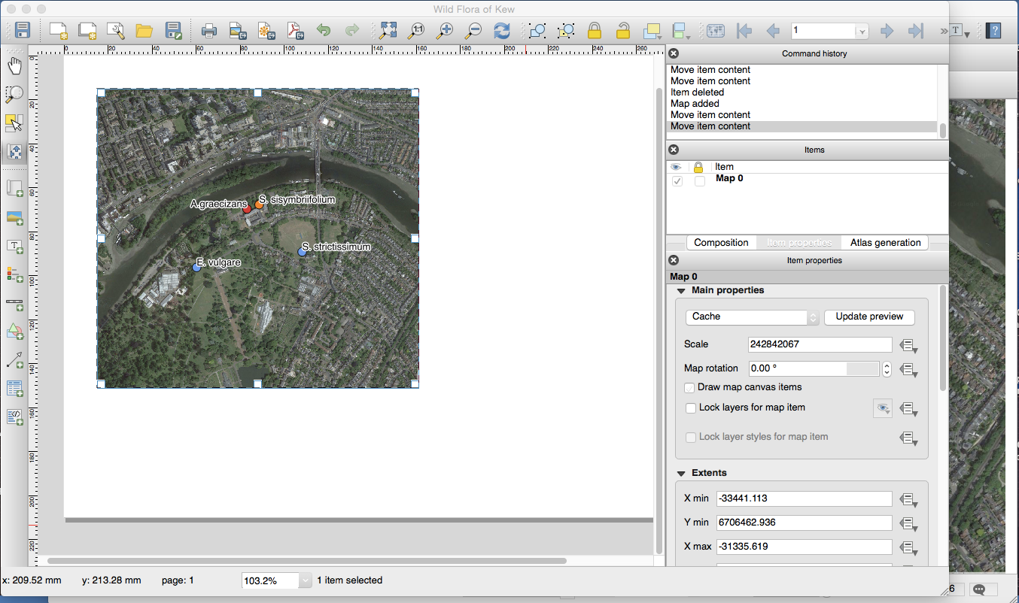
Zoom to North Arboretum
Add new map in composer
Use move map tool to position map

Slide 7
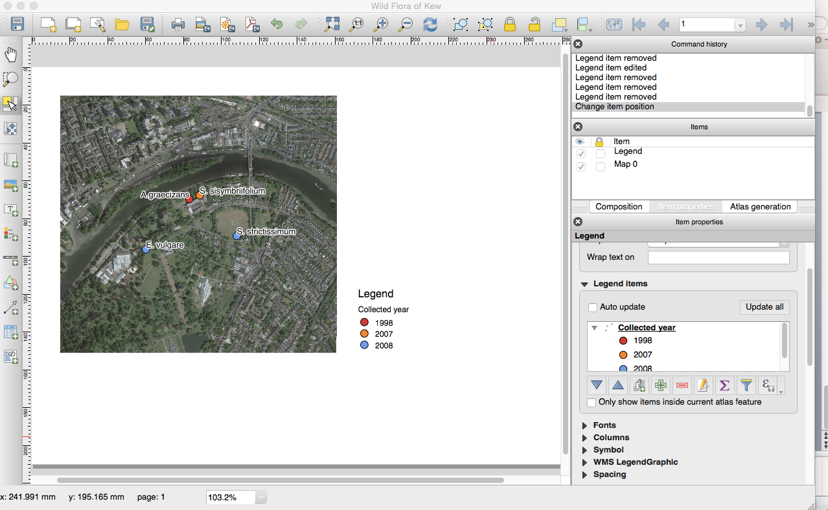
Add legend
Untoggle auto update
Get rid of things not needed
Change legend name

Slide 8
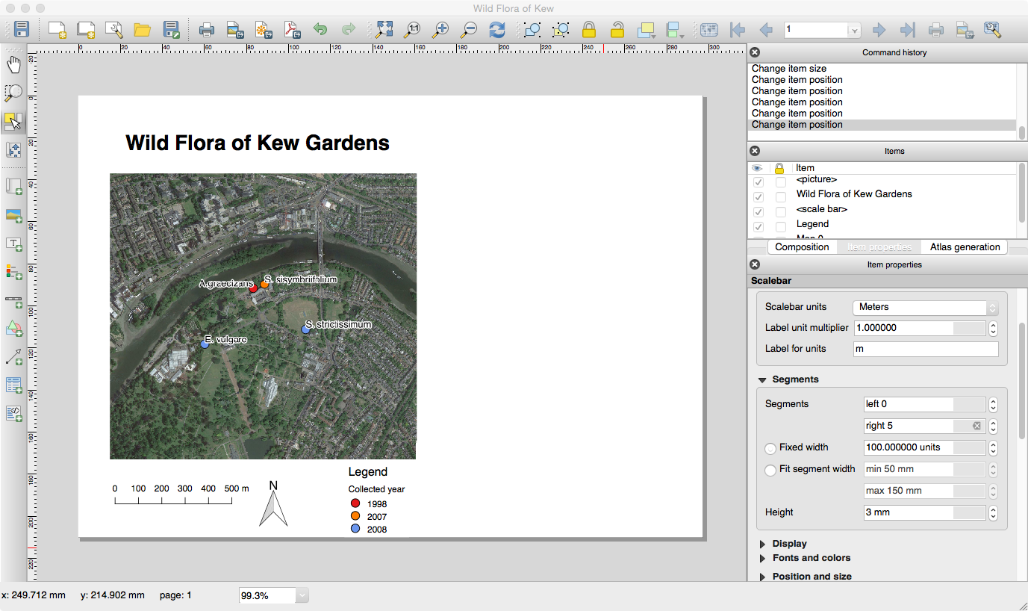
Add scale bar
Scale bar units (meters)
Add Title
Change font
Add North Arrow

Slide 9
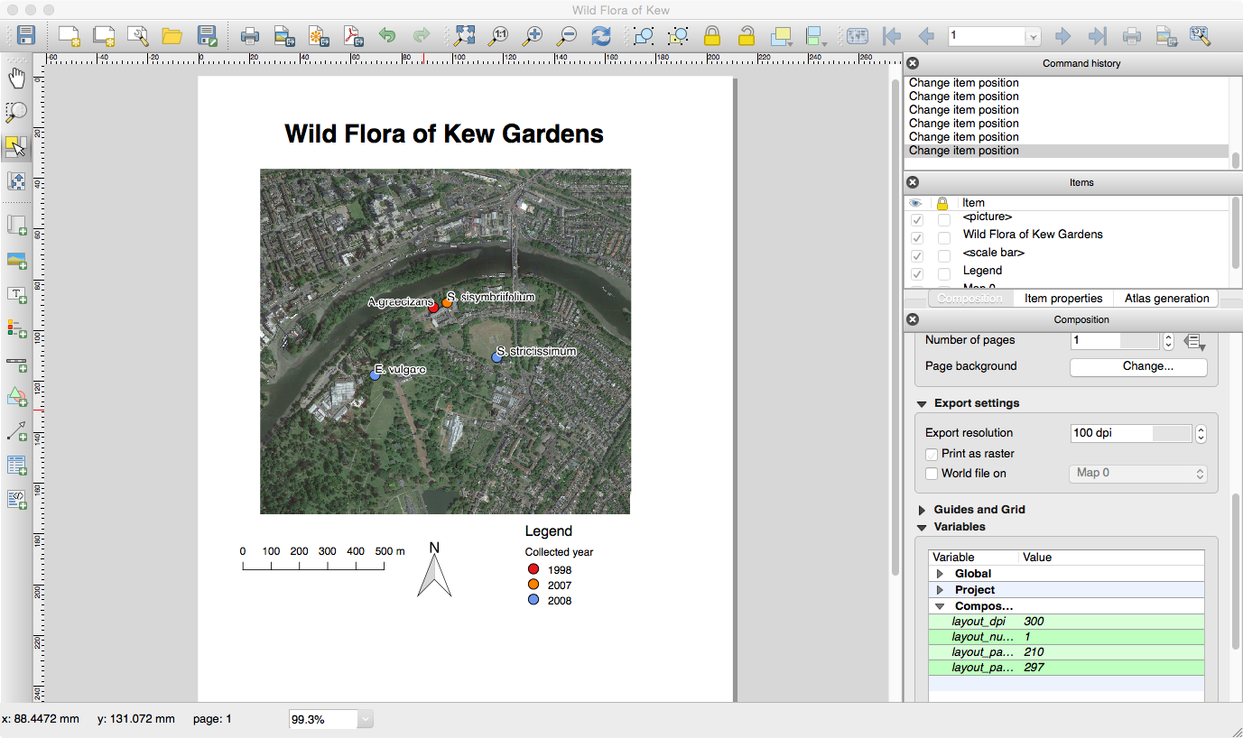
Go to ‘Composition’
Change to Portrait
Resolution = 100 dpi
Toggle print as Raster
Save as PDF

